Slide 1
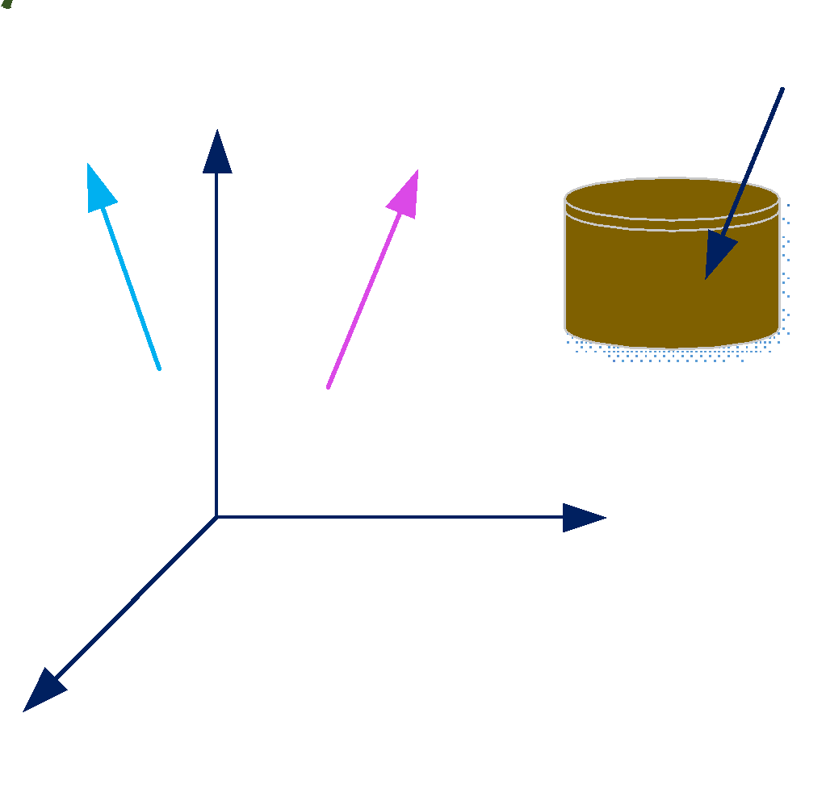
Assignment 2
What will be the transformation matrix for
The following transformation sequence ?
Rotate point x,y.z on the cylinder, around unit vector V1
Then translate the point along Y axis
Then rotate the point around unit vector V2
X/Y/Z are orthogonal to each other.
Point x,y,z and all other vectors are in the X/Y/Z co-ordinate
syste,m

